Slide 1
Course – DBMS
Course Instructor
Dr.Karanam Sunil Kumar
Department of CSE, BMSCE
28 November 2022

Slide 2
Unit-2
Data Modelling using the Entity-Relationship(ER) model: Using High-Level conceptual Data Models for Database Design, A sample Database Application, Entity types, Entity Sets, Attributes and Keys, Relationship Types, Relationship Sets, Roles and Structural Constraints, Weak Entity types, Refining the ER Design, ER Diagrams, Relationship Types of Degree Higher than two, Relational Database Design using ER-to-Relational Mapping.
Relational Algebra: Unary Relational Operations, SELECT and PROJECT, Relational Algebra Operations from Set Theory
Binary Relational Operations: JOIN and DIVISION, Additional Relational Operations, Examples of Queries in Relational Algebra.
28 November 2022

Slide 3
Unit-2
Data Modeling using the Entity-Relationship(ER) diagram
- Entity Types, Entity Sets, Attributes and Keys
28 November 2022

Slide 4
Sample Database Application
Example: HOD of CSE department calls you and asks to develop the following application
“Develop a database application to automate the process of course registration”
Your first task should be to have a discussion with your client i.e., HOD, to identify the requirements of the application.
  Requirements are as follows
    Department has students and faculty
    Department will offer a set of courses during each semester
    Each student in the department during course registration will be opting for courses offered by the department
    Faculty will be handling courses
Your second task should be to prepare a ER diagram which shows the Design plan of the database application to be developed.
28 November 2022

Slide 5
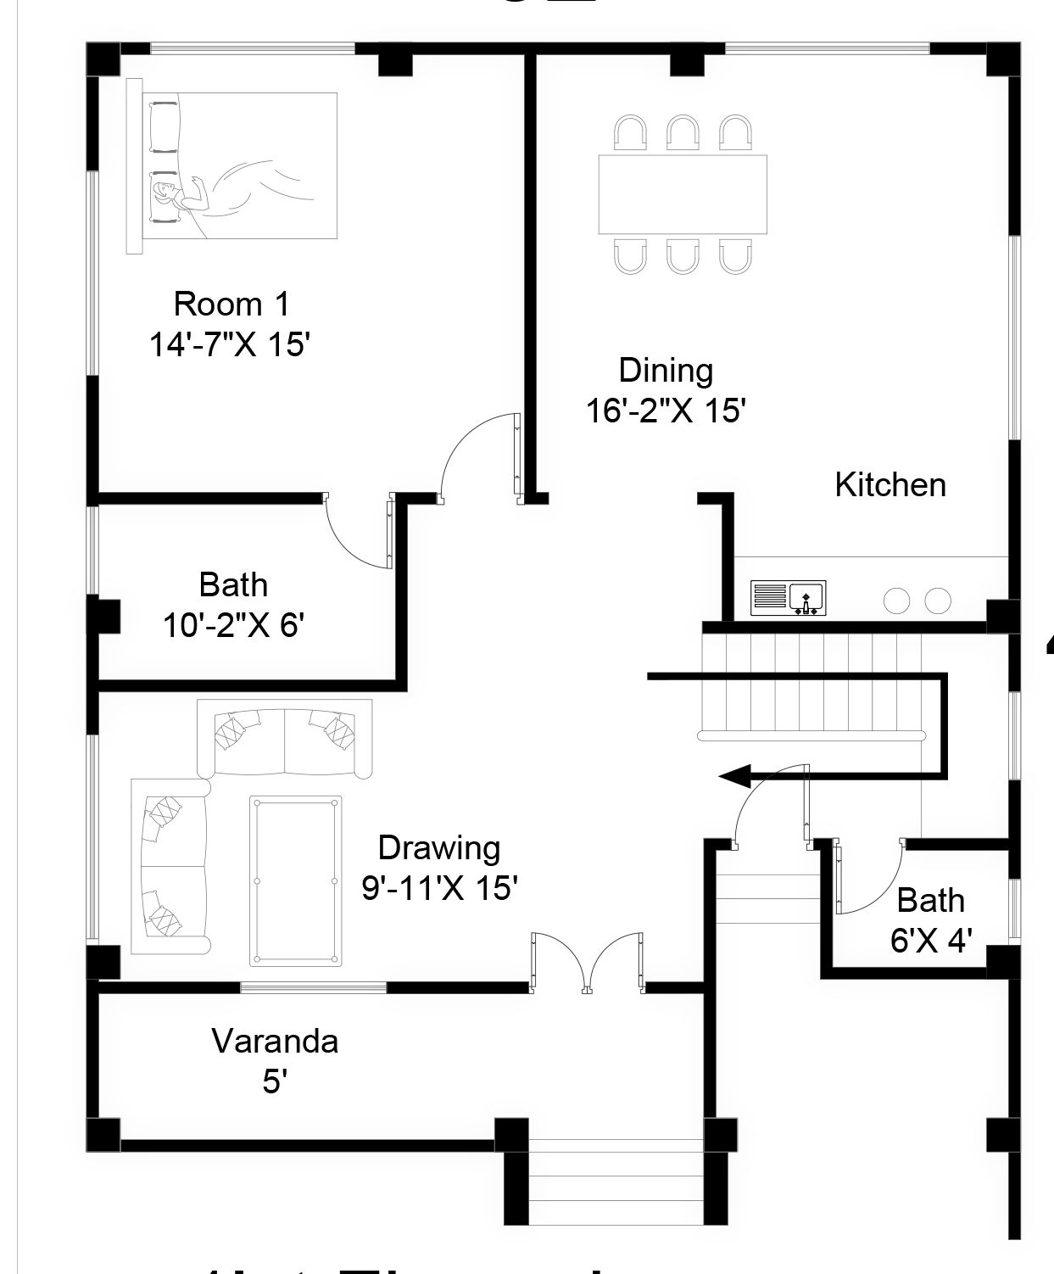
Example: House design plan
During plan preparation
Various notations and
Terminologies
28 November 2022

Slide 6
Design plan or ER diagram before actual development of the application
Course Code
CourseName
USN
Name
Student
Opting
Courses
has
Handles
Offers
has
Faculty
Department
ID
Name
Name
28 November 2022

Slide 7
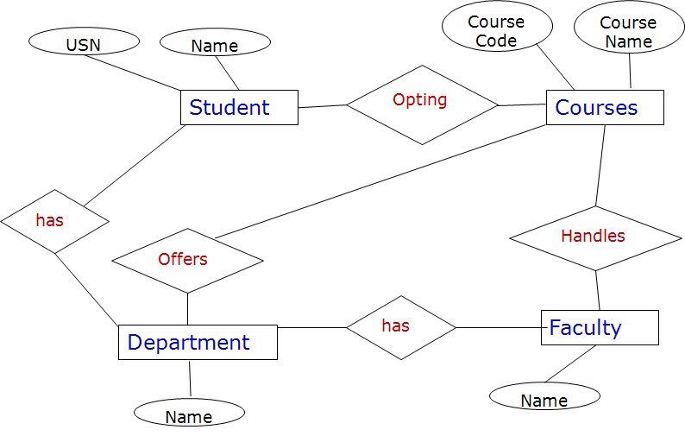
Design plan or ER diagram before actual development of the application
Attribute
Entity
Relationship
  Requirements Were
    - Department has students and faculty
    - Department will offer a set of courses during each semester
    - Each student in the department during course registration will be
    opting for courses offered by the department
    - Faculty will be handling courses
28 November 2022

Slide 8
Design plan or ER diagram before actual development of the application
Constraints
Each semester student
should register for minimum
of 20 credits and maximum
of 30 credits
Each faculty can handle
a maximum two courses
during each semester
  Requirements Were
    - Department has students and faculty
    - Department will offer a set of courses during each semester
    - Each student in the department during course registration will be
    opting for courses offered by the department
    - Faculty will be handling courses
28 November 2022

Slide 9
What is ER diagram ?
An Entity–Relationship model (ER model) describes the structure of a database with the help of a diagram, which is known as Entity Relationship Diagram (ER Diagram).
An ER model is a design or blueprint of a database that can later be implemented as a database.
It develops a conceptual design for the database. It also develops a very simple and easy to design view of data.
28 November 2022

Slide 10
What is Entity, Entity Types, Entity sets ?
Entity is object in real world which has independent existence.
  Example: Student, Course, Faculty, Car, House, College, Book, Food
ER Diagram Notation for Entity: Rectangle
Student
Courses
28 November 2022

Slide 11
What is Entity Types, Entity sets ?
Entity type is collection of entities with common attributes
Entity set collection of one or more attributes
Student
Entity Type
USN | Name | Email ID | Mobile No. | DOB
1BM14CS001 | Aditya | aditya@bmsce.ac.in | 9448444160 | 1-1-1997
1BM14CS002 | Bharath | bharath@bmsce.ac.in | 8762244699 | 31-12-1996
Entity Set
28 November 2022

Slide 12
What is Attribute ?
Attribute is a property that describes Entity.
Attributes:
USN, Name, Email ID,
Mobile Number, DOB
Student
Entity Type
USN | Name | Email ID | Mobile No. | DOB
1BM14CS001 | Aditya | aditya@bmsce.ac.in | 9448444160 | 1-1-1997
1BM14CS002 | Bharath | bharath@bmsce.ac.in | 8762244699 | 31-12-1996
Entity Set
What is Domain ?
Set of permitted values for an attribute.
28 November 2022

Slide 13
What is Attribute ?
Attribute is a property that describes Entity.
Attributes:
USN, Name, Email ID,
Mobile Number, DOB
Student
Entity Type
USN | Name | Email ID | Mobile No. | DOB
1BM14CS001 | Aditya | aditya@bmsce.ac.in | 9448444160 | 1-1-1997
1BM14CS002 | Bharath | bharath@bmsce.ac.in | 8762244699 | 31-12-1996
Entity Set
ER Diagram Notation for Attribute: Ellipse
Email ID
Mobile
No.
USN
Name
Student
DOB
28 November 2022

Slide 14
Activity - Questionnaire
List attributes for
Car
Book
28 November 2022

Slide 15
Example
Few attributes of Car are
Car_ID, Car_type, Car_color, Car_make…
Few attributes of Book are
Book_ID, Book_Title, Book_Publisher….
28 November 2022

Slide 16
Different categories of attributes
Simple (Atomic) vs Composite
  Attributes that are not divisible are called Simple.
  Attributes that can be divided into smaller parts are called Composite.
  Ex.: Simple- USN, Composite- Name(First Name, Last Name), Address(Street name, Area Name, Place)
Single value vs Multiple valued
  Ex.: Single – USN, Multiple – Mobile numbers
Stored vs Derived
  Ex.: Stored – DOB, Derived – Age
Complex Attributes
  Ex.: {Address(Street name, Area Name, Place)} → Office address and Residence Address
Null values
  Ex. : Middle Name is Optional i.e. Gautham Sharma or Gautham K Sharma
28 November 2022

Slide 17
Attribute: ER diagram notations
Attribute
…..
Composite Attribute
Multivalued Attribute
Derived Attribute
28 November 2022

Slide 18
What is Key ?
Key attribute is a attribute or a combination of attributes which will uniquely identify remaining attributes of entity.
USN | Name | Email ID | Mobile No. | DOB
1BM14CS001 | Aditya | aditya@bmsce.ac.in | 9448444160 | 1-1-1997
1BM14CS002 | Bharath | bharath@bmsce.ac.in | 8762244699 | 31-12-1996
ER Diagram Notation for Entity: Rectangle
USN
28 November 2022

Slide 19
Activity To DO
Attribute
Represent Employee entity
using ER diagram notation
Which has following attributes
Employee ID (Key)
Name
Address(House No., Street
name, Area name, Place)
Mobile Number (Can have
more than one )
DOB
Age
…..
Composite Attribute
Multivalued Attribute
Derived Attribute
Entity
______
Key Attribute
28 November 2022

Slide 20
Next we will learn
Unit 2:
Relationship Types, Relationship sets, Roles and Structural Constraints
Weak Entity Types
28 November 2022

Slide 21
Relationship Type
A relationship type represents the association between entity types
Example, an Faculty works_for a department, a student enrolls_for in a course. Here, works_for and enrolls_for are called relationships.
relationship
Faculty
Works_for
Department
Student
Enrolls_for
Course
28 November 2022

Slide 22
Relationship Type
A Relationship Type defines a relationship set among entities of certain entity types.
Example, an Faculty works_for a department, a student enrolls_for in a course. Here, works_for and enrolls_for are called relationships.
Dr. Guruprasad
Dr. Umadevi
Dr. Indiramma
Dr. Ashok
CSE
ISE
Faculty
Entity
Works_for
relationship
Department
Entity
28 November 2022

Slide 23
Relationship Type
A Relationship Type defines a relationship set among entities of certain entity types.
Example, an Faculty works_for a department, a student enrolls_for in a course. Here, works_for and enrolls are called relationships.
Avinash
Balaji
Chandan
Dinesh
DBMS
Java
Student
Entity
enrolls_for
relationship
Course
Entity
28 November 2022

Slide 24
Relationship Set
An Relationship Set is a collection of relationships all belonging to one relationship type.
Here relationship set,
has 4 relationships
Avinash
Balaji
Chandan
Dinesh
DBMS
Java
Student
Entity
enrolls_for
relationship
Course
Entity
28 November 2022

Slide 25
Relationship
The association among entities is called a relationship. or A Relationship is one instance in a Relationship Set.
Avinash
Balaji
Chandan
Dinesh
DBMS
Java
Student
Entity
enrolls_for
relationship
Course
Entity
28 November 2022

Slide 26
Relationship Degree
Binary Relationship: Degree two, two entities are participating
Dr. Guruprasad
Dr. Umadevi
Dr. Indiramma
Dr. Ashok
CSE
ISE
Faculty
Entity
Works_for
relationship
Department
Entity
28 November 2022

Slide 27
Relationship Degree
Ternary Relationship: Degree three, three entities are participating
Micro Systems Pvt. Ltd
UNIQ systems
Pvt. Ltd
Laptop
Manufacturing
Desktop
Manufacturing
Supplier
Entity
Hard disk
Keyboard
supplies
relationship
Project
Entity
Part
Entity
28 November 2022

Slide 28
Relationship Degree
Ternary Relationship: Degree three, three entities are participating
Micro Systems Pvt. Ltd
UNIQ systems
Pvt. Ltd
Laptop
Manufacturing
Desktop
Manufacturing
Supplier
Entity
Hard disk
Keyboard
supplies
relationship
Project
Entity
Part
Entity
28 November 2022

Slide 29
Recursive Relationship
In some cases the same entity type participates in more than once in a relationship type in different roles.
Dr. Guruprasad
Dr. Umadevi
Dr. Indiramma
Supervisor
Subordinate
Subordinate
Faculty
Entity
supervision
relationship
28 November 2022

Slide 30
Recursive Relationship
In some cases the same entity type participates in more than once in a relationship type in different roles.
Subordinate
Dr. Guruprasad
Dr. Umadevi
Dr. Indiramma
Principal
Supervisor
Supervisor
Faculty
Entity
supervision
relationship
28 November 2022

Slide 31
ER Diagram Notations
Attribute
Relationship
…..
Composite Attribute
Multivalued Attribute
Derived Attribute
Entity
______
Key Attribute
28 November 2022

Slide 32
Relationship Constraints or Structural Constraints
Two Types
Cardinality Ratios
  One to one (1:1)
  One to Many (1:M)
  Many to Many (N:M)
Participation Constraints
  Total
  Partial
28 November 2022

Slide 33
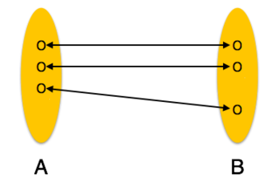
Cardinality Ratios
Cardinality is a constraint on a relationship specifying the number of entity instances that a specific entity may be related to via the relationship.
One to One:
One entity from entity set A can be associated with at most one entity of entity set B and vice versa.
28 November 2022

Slide 34
Cardinality Ratios
Cardinality is a constraint on a relationship specifying the number of entity instances that a specific entity may be related to via the relationship.
One to One:
One entity from entity set A can be associated with at most one entity of entity set B and vice versa.
Dr. Guruprasad
Dr. Gowrishankar
CSE
ISE
Faculty
Entity
Department
Entity
Heads
relationship
28 November 2022

Slide 35
Cardinality Ratios
Cardinality is a constraint on a relationship specifying the number of entity instances that a specific entity may be related to via the relationship.
One to One:
One instance of one entity type can participate in one instance of other entity type.
1
1
Faculty
Heads
Department
28 November 2022

Slide 36
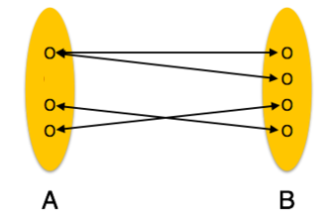
Cardinality Ratios
Cardinality is a constraint on a relationship specifying the number of entity instances that a specific entity may be related to via the relationship.
One to Many:
One entity from entity set A can be associated with more than one entities of entity set B however an entity from entity set B, can be associated with at most one entity.
1
M
Entity A
R
Entity B
28 November 2022

Slide 37
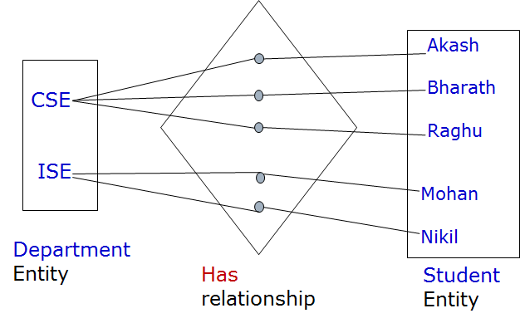
Cardinality Ratios
Cardinality is a constraint on a relationship specifying the number of entity instances that a specific entity may be related to via the relationship.
One to Many:
One entity from entity set A can be associated with more than one entities of entity set B however an entity from entity set B, can be associated with at most one entity.
Department
1
M
Has
Student
28 November 2022

Slide 38
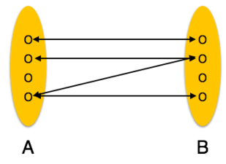
Cardinality Ratios
Cardinality is a constraint on a relationship specifying the number of entity instances that a specific entity may be related to via the relationship.
Many to Many:
One entity from A can be associated with more than one entity from B and vice versa.
N
M
Entity A
R
Entity B
28 November 2022

Slide 39
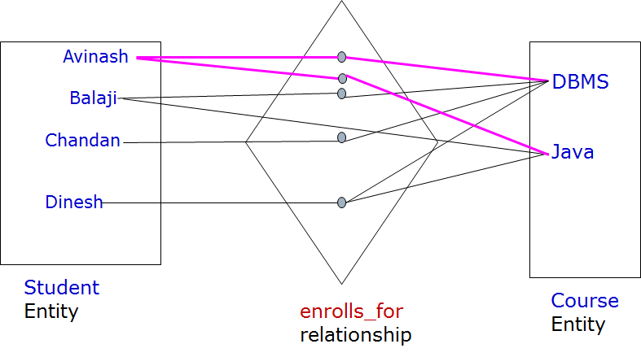
Cardinality Ratios
Cardinality is a constraint on a relationship specifying the number of entity instances that a specific entity may be related to via the relationship.
Many to Many:
One entity from A can be associated with more than one entity from B and vice versa.
28 November 2022

Slide 40
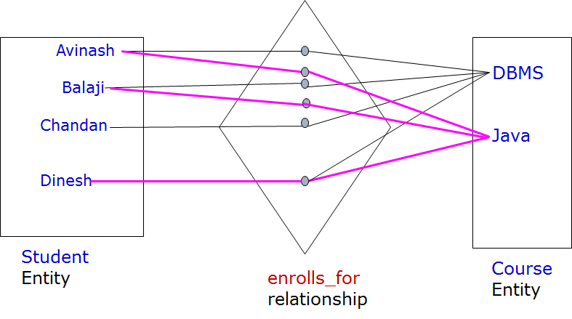
Cardinality Ratios
Cardinality is a constraint on a relationship specifying the number of entity instances that a specific entity may be related to via the relationship.
Many to Many:
One entity from A can be associated with more than one entity from B and vice versa.
28 November 2022

Slide 41
Participation Constraint
Minimum number of relationship instance that each entity can participate in.
Total Participation − Each entity is involved in the relationship. Total participation is represented by double lines.
Partial participation − Not all entities are involved in the relationship. Partial participation is represented by single lines.
28 November 2022

Slide 42
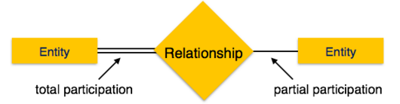
Participation Constraint
Minimum number of relationship instance that each entity can participate in.
Total Participation − Each entity is involved in the relationship. Total participation is represented by double lines.
Partial participation − Not all entities are involved in the relationship. Partial participation is represented by single lines.
28 November 2022

Slide 43
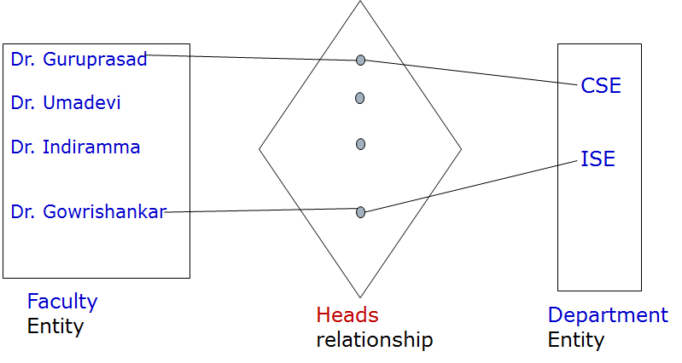
Participation Constraint
Minimum number of relationship instance that each entity can participate in.
Total Participation − Each entity is involved in the relationship. Total participation is represented by double lines.
Partial participation − Not all entities are involved in the relationship. Partial participation is represented by single lines.
28 November 2022

Slide 44
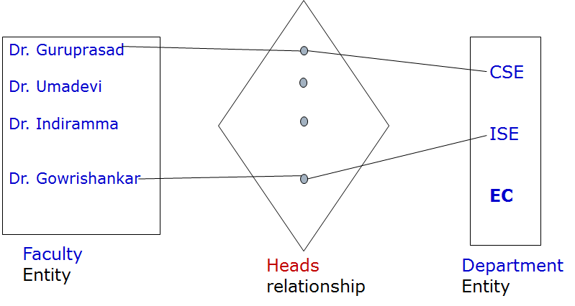
Participation Constraint
Minimum number of relationship instance that each entity can participate in.
Total Participation − Each entity is involved in the relationship. Total participation is represented by double lines.
Partial participation − Not all entities are involved in the relationship. Partial participation is represented by single lines.
What is wrong in following relationship representation ?
28 November 2022

Slide 45
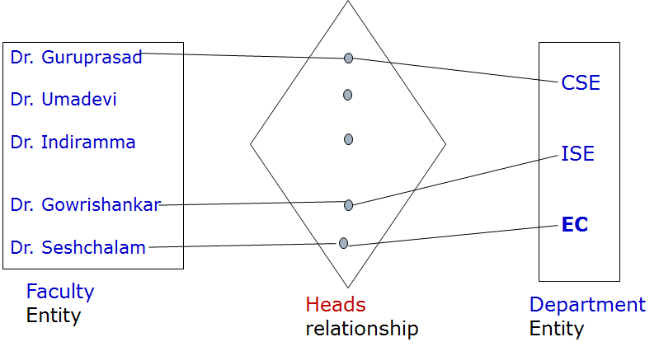

Participation Constraint
Minimum number of relationship instance that each entity can participate in.
Total Participation − Each entity is involved in the relationship. Total participation is represented by double lines.
Partial participation − Not all entities are involved in the relationship. Partial participation is represented by single lines.
28 November 2022

Slide 46
Weak Entity
A weak entity set is one which does not have any primary key associated with it.
A weak entity type normally has partial key which is the set of attributes that can uniquely identify weak entities that are related to same owner entity.
The relationship that relates the weak entity type to an owner entity type is known as identifying relationship. The weak entity type always has total participation(existence dependency) in a relationship because the weak entity type can not be identified without an owner identity.
Partial
Key
Name
-----
Faculty
Dependent
Dependents_of
Owner
Entity
Weak
Entity
Identifying
Relationship
28 November 2022

Slide 47
Weak Entity
A weak entity set is one which does not have any primary key associated with it.
A weak entity type normally has partial key which is the set of attributes that can uniquely identify weak entities that are related to same owner entity.
Ram
Ravi
Ram
Dr. Sharma
Dr. Reddy
Owner
Entity
Dependents_of
relationship
Dependent (Children)
Entity
28 November 2022

Slide 48
ER Diagram Symbols
Attribute
…..
Composite Attribute
Multivalued Attribute
Derived Attribute
Entity
Weak Entity
______
Key Attribute
_ _ _ _
Partial Key
28 November 2022

Slide 49


ER Diagram Symbols
Relationship
Identifying Relationship
Total Participation of Entity A in R
Cardinality Ratio 1:N for Entity A : B in R
28 November 2022

Slide 50
Topics Covered in Todays Class
Unit 2:
ER diagram design for a given requirements
28 November 2022

Slide 51
Database Design
Database design: Why do we need it ?
Agree on structure of the database before deciding on a particular implementation
Consideration Issues such as:
What entities to model
How entities are related
What constraints exist in the domain
How to achieve good design
ER diagram is a conceptual design of database
28 November 2022

Slide 52
Database Design Process
Requirement
Analysis
Conceptual
Design
Logical, Physical, Security etc.,
Requirement Analysis
- What is going to be stored ?
- How is it going to be used ?
- What are we going to do with the data ?
- Who should access the data ?
Technical and Non-technical
people are involved
28 November 2022

Slide 53
Database Design Process
Requirement
Analysis
Conceptual
Design
Logical, Physical, Security etc.,
Conceptual Design
- A high-level description of the database.
- Sufficiently precise that technical people can understand it.
- But, not so precise that non-technical can not participate.
This is were Entity-Relationship (ER)
Diagram fits in.
28 November 2022

Slide 54
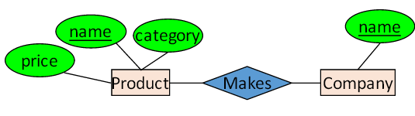
Database Design Process
Requirement
Analysis
Conceptual
Design
Logical, Physical, Security etc.,
ER diagram is visual syntax for DB design which
is precise enough for technical points, but abstracted
enough for non-technical people.
28 November 2022

Slide 55

Main phases of Database Design
28 November 2022

Slide 56
Main phases of Database Design
The first step shown is requirements collection and analysis. During this step, the database designers interview prospective database users to understand and document their data requirements.
The next step is to create a conceptual schema for the database, using a high-level conceptual data model. This step is called conceptual design. The conceptual schema is a concise description of the data requirements of the users and includes detailed descriptions of the entity types, relationships, and constraints; these are expressed using the concepts provided by the high-level data model
The next step in database design is the actual implementation of the database, using a commercial DBMS. This step is called logical design or data model mapping; its result is a database schema in the implementation data model of the DBMS.
The last step is the physical design phase, during which the internal storage structures, file organizations, indexes, access paths, and physical design parameters for the database files are specified. In parallel with these activities, application programs are designed and implemented as database transactions corresponding to the high level transaction specifications.
28 November 2022

Slide 57
ER Diagram Symbols
Attribute
…..
Composite Attribute
Multivalued Attribute
Derived Attribute
Entity
Weak Entity
______
Key Attribute
_ _ _ _
Partial Key
28 November 2022

Slide 58
ER Diagram Symbols
Relationship
Identifying Relationship
Total Participation of Entity A in R
Cardinality Ratio 1:N for Entity A : B in R
28 November 2022

Slide 59
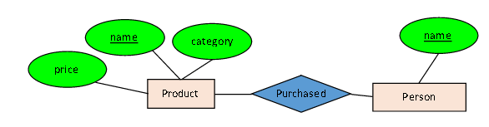
Activity: ER diagram
Decision: Relationship vs Empty
Question 1: What does the following ER diagram say ?
28 November 2022

Slide 60
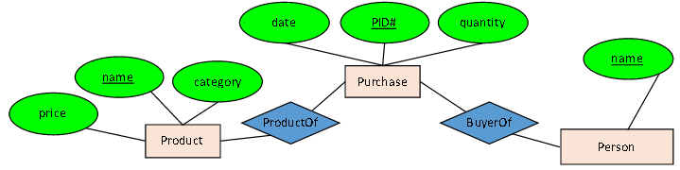
Activity: ER diagram
Decision: Relationship vs Empty
Question 2: What does the following ER diagram say ?
28 November 2022

Slide 61
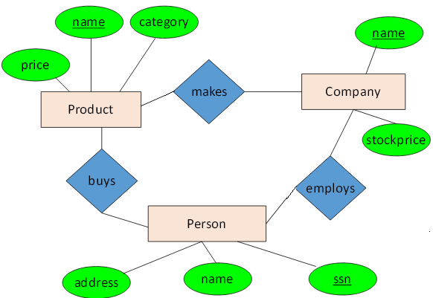
Activity: ER diagram
Decision: Relationship vs Empty
Question 3: What does the following ER diagram say ?
28 November 2022

Slide 62
Activity: ER diagram design
Draw ER diagram for the following requirements
Universal Records has decided to store information about musicians who perform on its albums (as well as other company data) in a database.
Each musician that records at Universal has an ID(Key) and name.
Each instrument used in songs recorded at Universal has a unique identification number (Key) , a name and a musical key.
Each album recorded on the Universal label has a unique identification number (Key) , a title, a copyright date and a format.
Each song recorded at Universal has a Song ID (Key), a title and an author.
Each musician may play several instruments, and a given instrument may be played by several musicians.
Each album has a number of songs on it, but no song may appear on more than one album.
Each song is performed by one or more musicians, and a musician may perform a number of songs.
Each album has exactly one musician who acts as its producer. A musician may produce several albums, of course.
28 November 2022

Slide 63
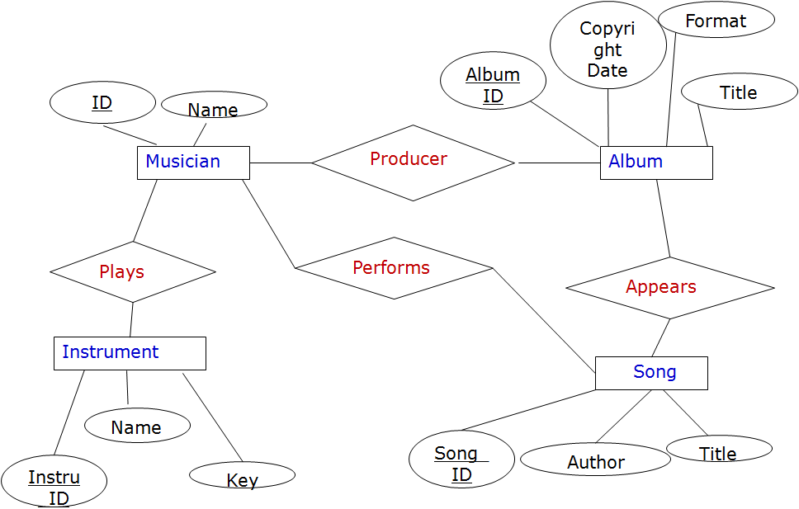
Each musician that records at Universal has an ID (Key) and name.
28 November 2022

Slide 64
Each instrument used in songs recorded at Universal has a unique identification number (Key) , a name and a musical key.
28 November 2022

Slide 65
Each album recorded on the Universal label has a unique identification number (Key) , a title, a copyright date and a format.
28 November 2022

Slide 66
Each song recorded at Universal has a Song ID (Key), a title and an author.
28 November 2022

Slide 67
Each musician may play several instruments, and a given instrument may be played by several musicians.
M
N
28 November 2022

Slide 68
Each album has a number of songs on it, but no song may appear on more than one album.
1
M
28 November 2022

Slide 69
Each song is performed by one or more musicians, and a musician may perform a number of songs.
M
1
M
N
N
N
28 November 2022

Slide 70
Each album has exactly one musician who acts as its producer. A musician may produce several albums, of course
1
M
M
M
1
N
N
M
28 November 2022

Slide 71
Next we will Learn
Unit 2:
Converting ER Diagrams to Tables
or Database design using ER-to-Relational Mapping
28 November 2022

Slide 72
ER diagram
An ER diagram is a pictorial representation of the information that can be captured by a database. Such a “picture” serves two purposes:
  It allows database professionals to describe an overall design concisely yet accurately.
  (Most of) it can be easily transformed into the relational schema.
The ER diagram represents the conceptual level of database design meanwhile the relational schema (or database table) is the logical level for the database design.
28 November 2022

Slide 73
Converting ER diagram to Tables
Entities and Simple Attributes
  An entity type within ER diagram is turned into a table.
  Each attribute turns into a column (attribute) in the table. The key attribute of the entity is the primary key of the table which is usually underlined.
USN
DOB
Name
Student
Student Table
USN | Name | DOB
1BM14CS001 | Aditya | 1-1-1997
1BM14CS002 | Bharath | 31-12-1996
Primary
Key
28 November 2022

Slide 74
Converting ER diagram to Tables
Multi-Valued Attributes
USN
DOB
Name
Student
Mobile
28 November 2022

Slide 75
Converting ER diagram to Tables
Multi-Valued Attributes
USN
DOB
Name
Student
Mobile
Which of the following representation of the table for Multivalued Attribute is best ?
USN | Name | DOB | Mobile 1 | Mobile 2
1BM14CS001 | Aditya | 1-1-1997 | 8766655433
1BM14CS002 | Bharath | 31-12-1996 | 9762255433 | 7066722433
Student Table
Mobile Table
USN | Mobile
1BM14CS001 | 8766655433
1BM14CS002 | 9762255433
1BM14CS002 | 7066722433
USN | Name | DOB
1BM14CS001 | Aditya | 1-1-1997
1BM14CS002 | Bharath | 31-12-1996
28 November 2022

Slide 76
Converting ER diagram to Tables
Multi-Valued Attributes
USN
DOB
Name
Primary
Key
Student
Mobile
Student Table
Mobile Table
USN | Name | DOB
1BM14CS001 | Aditya | 1-1-1997
1BM14CS002 | Bharath | 31-12-1996
Foreign
Key
USN | Mobile
1BM14CS001 | 8766655433
1BM14CS002 | 9762255433
1BM14CS002 | 7066722433
If you have a multi-valued attribute, take the attribute and turn it into a
new entity or table of its own. Then make a 1:N relationship between
the new entity and the existing one. In simple words,
Create a table for the attribute.
Add the primary (id) column of the parent entity as a foreign key
within the new table
28 November 2022

Slide 77
Converting ER diagram to Tables
Street
Name
Area
Name
Composite Attribute
DOB
Address
Place
USN
Name
Student
Mobile
28 November 2022
Notes:
Address(Street name, Area Name, Place)

Slide 78
Converting ER diagram to Tables
Street
Name
Area
Name
Composite Attribute
DOB
Address
Place
USN
Name
Student
Mobile
Student Table
USN | Name | DOB | Street | Area | Place
1BM14CS001 | Aditya | 1-1-1997 | RK Road | Nagar | Mandya
1BM14CS002 | Bharath | 31-7-1996 | S V Road | Layout | Kolar
USN | Mobile
1BM14CS001 | 8766655433
1BM14CS002 | 9762255433
1BM14CS002 | 7066722433
Mobile Table
28 November 2022
Notes:
Address(Street name, Area Name, Place)

Slide 79
Converting ER diagram to Tables
Street
Name
Area
Name
Derived Attribute
DOB
Address
Place
USN
Name
Age
Student
Mobile
Student Table
USN | Name | DOB | Street | Area | Place
1BM14CS001 | Aditya | 1-1-1997 | RK Road | Nagar | Mandya
1BM14CS002 | Bharath | 31-7-1996 | S V Road | Layout | Kolar
USN | Mobile
1BM14CS001 | 8766655433
1BM14CS002 | 9762255433
1BM14CS002 | 7066722433
Mobile Table
28 November 2022
Notes:
Address(Street name, Area Name, Place)

Slide 80
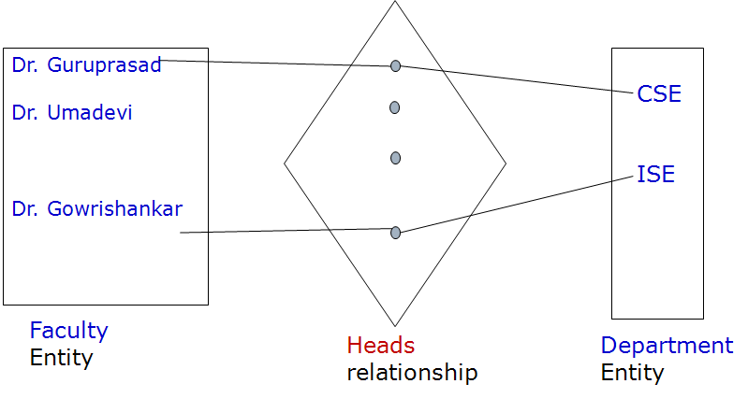
Converting ER diagram to Tables
Relationship: One-to-One
D-ID
F-ID
1
1
F-Name
D-Name
28 November 2022

Slide 81
Converting ER diagram to Tables
Relationship: One-to-One
D-ID
F-ID
1
1
F-Name
D-Name
Approach 1: Foreign Key
Faculty Table
Department Table
F-ID | F-Name
1 | Dr. H S Guruprasad
2 | Dr. Umadevi V
3 | Dr. Gowrishankar
D-ID | D-Name | Heading F-ID
10 | CSE | 1
20 | ISE | 3
28 November 2022

Slide 82
Converting ER diagram to Tables
Relationship: One-to-One
D-ID
F-ID
1
1
F-Name
D-Name
Approach 1: Foreign Key
Department Table
Primary
Key
Primary
Key
Foreign
Key
Faculty Table
F-ID | F-Name
1 | Dr. H S Guruprasad
2 | Dr. Umadevi V
3 | Dr. Gowrishankar
D-ID | D-Name | Heading F-ID
10 | CSE | 1
20 | ISE | 3
28 November 2022

Slide 83
Converting ER diagram to Tables
Relationship: One-to-One
D-ID
F-ID
1
1
F-Name
D-Name
Approach 2: Merged Relation approach
Merging two entity types and relationship into one single relation.
This may be appropriate when both participations are total
Faculty –Department Table
F-ID | F-Name | D-ID | D-Name | HOD
1 | Dr. H S Guruprasad | 10 | CSE | Yes
2 | Dr. Umadevi V | 10 | CSE | No
3 | Dr. Gowrishankar | 20 | ISE | Yes
28 November 2022

Slide 84
Converting ER diagram to Tables
Relationship: One-to-One
D-ID
F-ID
1
1
F-Name
D-Name
Approach 3: Cross-reference or relationship relation approach
Faculty Table
Department Table
HOD Table
F-ID | F-Name
1 | Dr. H S Guruprasad
2 | Dr. Umadevi V
3 | Dr. Gowrishankar
D-ID | D-Name
10 | CSE
20 | ISE
D-ID | F-ID
10 | 1
20 | 3
Lookup Table
28 November 2022

Slide 85
Converting ER diagram to Tables
Relationship: One-to-Many
USN
D-ID
1
M
Department
Has
Student
D-Name
S-Name
28 November 2022

Slide 86
Converting ER diagram to Tables
Relationship: One-to-Many
USN
D-ID
1
M
Department
Has
Student
D-Name
S-Name
Approach 1
Student Table
Department Table
USN | S-Name | D-ID
1BM14CS001 | Akash | 10
1BM14CS002 | Bharath | 10
1BM14CS003 | Ragu | 10
1BM14CS004 | Mohan | 20
1BM14CS005 | Nikil | 20
D-ID | D-Name
10 | CSE
20 | ISE
28 November 2022

Slide 87
Converting ER diagram to Tables
Relationship: One-to-Many
USN
D-ID
1
M
Department
Has
Student
D-Name
S-Name
Approach 2
Student Table
Department
Student Table
Department Table
USN | S-Name
1BM14CS001 | Akash
1BM14CS002 | Bharath
1BM14CS003 | Ragu
1BM14CS004 | Mohan
1BM14CS005 | Nikil
D-ID | D-Name
10 | CSE
20 | ISE
USN | D-ID
1BM14CS001 | 10
1BM14CS002 | 10
1BM14CS003 | 10
1BM14CS004 | 20
1BM14CS005 | 20
28 November 2022

Slide 88
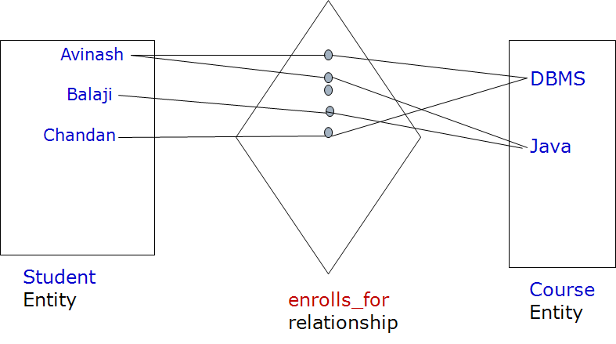
Converting ER diagram to Tables
Relationship: Many-to-Many
USN
C-ID
Student
Enrolls_for
Course
S-Name
C-Name
28 November 2022

Slide 89
Converting ER diagram to Tables
Relationship: Many-to-Many
USN
C-ID
Student
Enrolls_for
Course
S-Name
C-Name
Student Table
Course Table
Student
Course Table
USN | S-Name
1BM14CS001 | Avinash
1BM14CS002 | Balaji
1BM14CS003 | Chandan
C-ID | C-Name
10 | DBMS
20 | Java
USN | C-ID
1BM14CS001 | 10
1BM14CS001 | 20
1BM14CS002 | 20
1BM14CS003 | 10
28 November 2022

Slide 90
Converting ER diagram to Tables
Relationship: Many-to-Many
USN
C-ID
Student
Enrolls_for
Course
S-Name
C-Name
Student Table
Course Table
Student
Course Table
USN | S-Name
1BM14CS001 | Avinash
1BM14CS002 | Balaji
1BM14CS003 | Chandan
C-ID | C-Name
10 | DBMS
20 | Java
USN | C-ID
1BM14CS001 | 10
1BM14CS001 | 20
1BM14CS002 | 20
1BM14CS003 | 10
28 November 2022

Slide 91
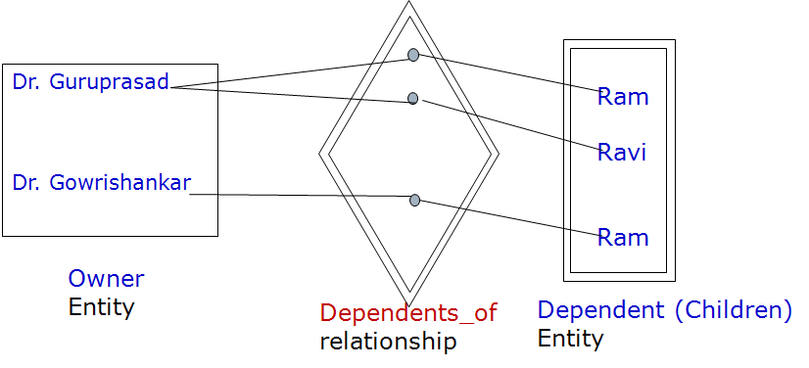
Converting ER diagram to Tables
Partial
Key
Name
-----
F-ID
F-Name
Faculty
Dependent
Dependents_of
Owner
Entity
Identifying
Relationship
Weak
Entity
28 November 2022

Slide 92
Converting ER diagram to Tables
Partial
Key
Name
-----
Weak Entity
F-ID
F-Name
Faculty
Dependent
Dependents_of
Owner
Entity
Identifying
Relationship
Weak
Entity
Faculty Table
Dependent Table
F-ID | F-Name
10 | Dr. Guruprasad
20 | Dr. Gowrishankar
F-ID | Dependent Name
10 | Ram
10 | Ravi
20 | Ram
28 November 2022

Slide 93
Activity To Do
Convert the Following ER diagram to Database table schema
1
M
M
M
1
N
N
M
28 November 2022

Slide 94
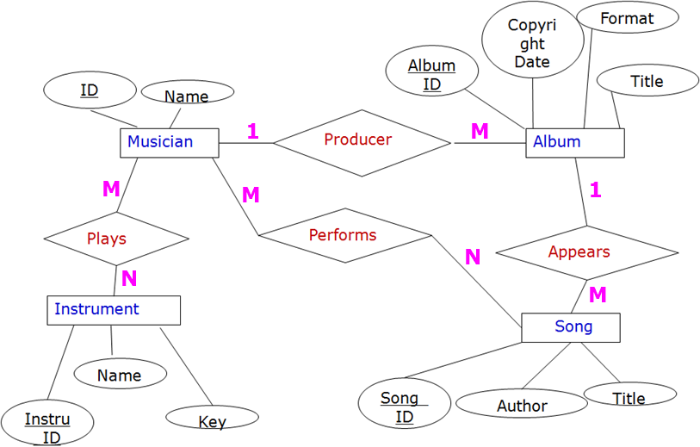
Database tables or Schema Diagram
Musician Table
Name | Muscian-ID
Album Table
Album-ID | Copyright Date | Format | Title | Producer ID
Song Table
Song-ID | Author | Title | Album-ID
Performing Table
Muscian-ID | Song-ID
Plays Table
Muscian-ID | Instr-ID
Instrument Table
Instr-ID | Name | M-Key
28 November 2022

Slide 95
Database tables or Schema Diagram
Musician Table
Name | Muscian-ID
Album Table
Album-ID | Copyright Date | Format | Title | Producer ID
Song Table
Song-ID | Author | Title | Album-ID
Performing Table
Muscian-ID | Song-ID
Plays Table
Muscian-ID | Instr-ID
Instrument Table
Instr-ID | Name | M-Key
28 November 2022

Slide 96
Thanks for Listening
28 November 2022

Slide 97
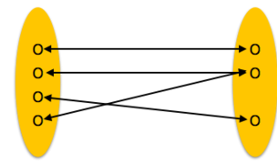
Cardinality Ratios
Cardinality is a constraint on a relationship specifying the number of entity instances that a specific entity may be related to via the relationship.
Many to One:
More than one entities from entity set A can be associated with at most one entity of entity set B, however an entity from entity set B can be associated with more than one entity from entity set A.
N
1
Entity A
R
Entity B
28 November 2022

